Slide 1

#LifeKoKaroLift
Be sincere, not serious !

Slide 2

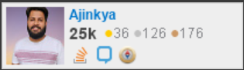
Ajinkya Parakh
Lead Architect
Avid Stackoverflower!
Trainer / Mentor
Content Creator
1X Developer !!
Notes:
https://www.youtube.com/watch?v=2NFH3VC6LNs

Slide 3



Course : Experiential Learning
Session On : Software Testing

Slide 4
Building Right Thing
Vs
Building Thing Right
Notes:
https://www.youtube.com/watch?v=2NFH3VC6LNs

Slide 5
Types Of Testing?

Slide 6
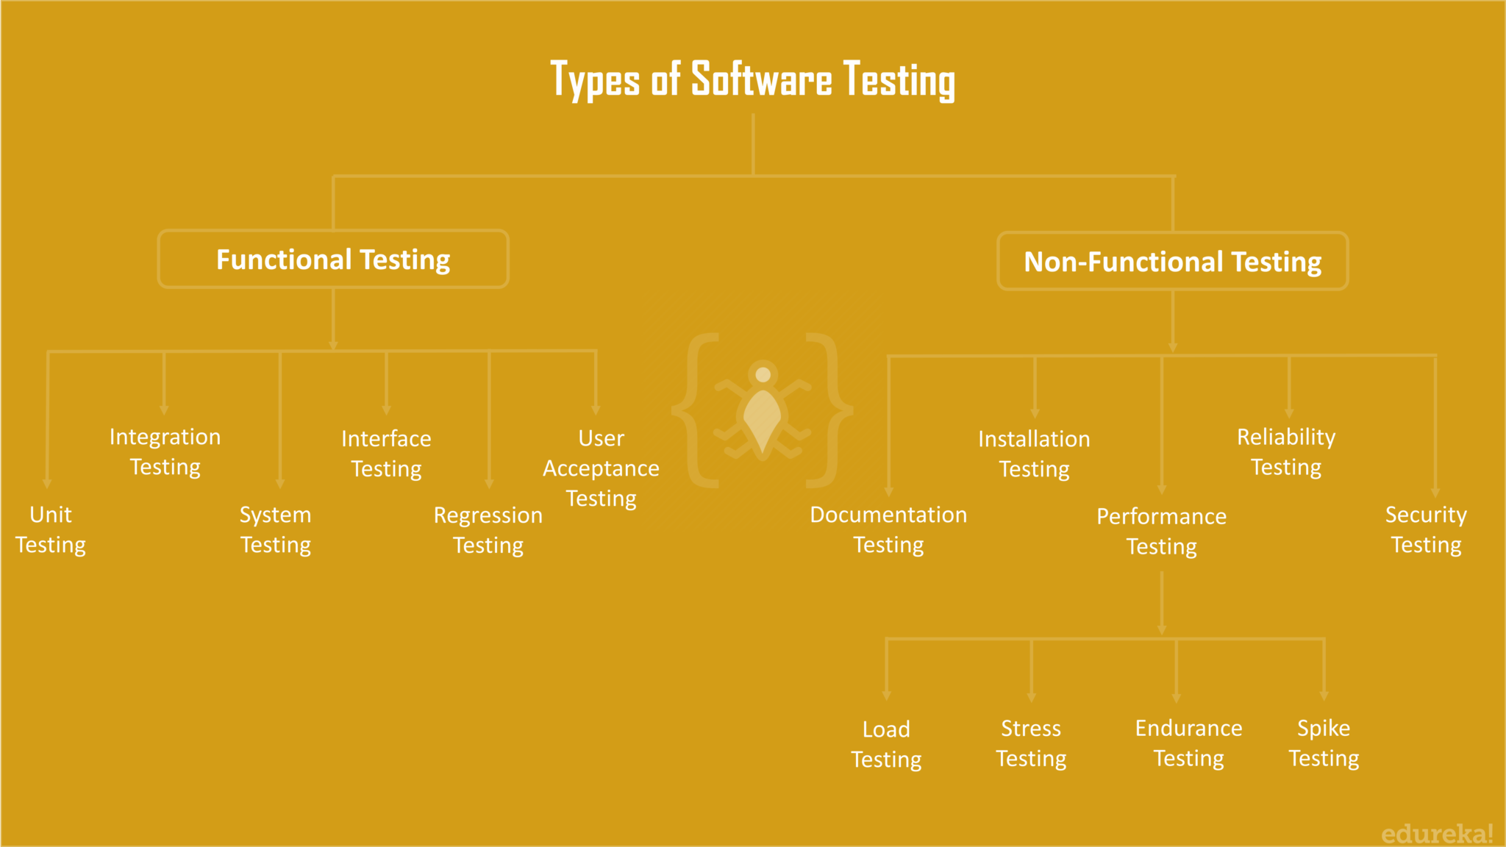
SDLC

Slide 7
Application Lifecycle
Where To Test?

Slide 8
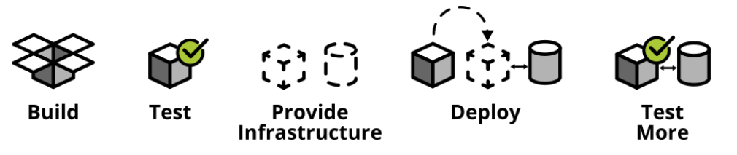
Application Lifecycle

Slide 9
How much should we test?

Slide 10
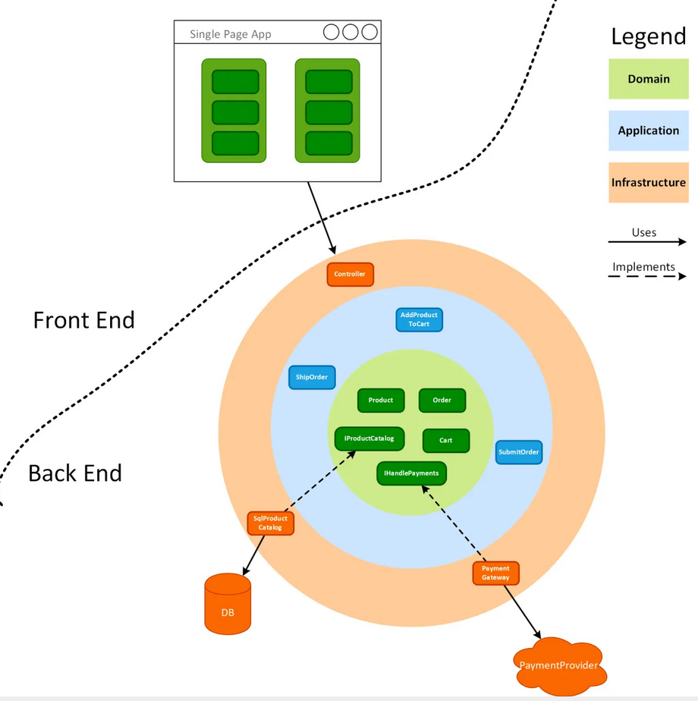
High Level Arch

Slide 11
Unit Test
Notes:
What makes unit?
Intent

Slide 12
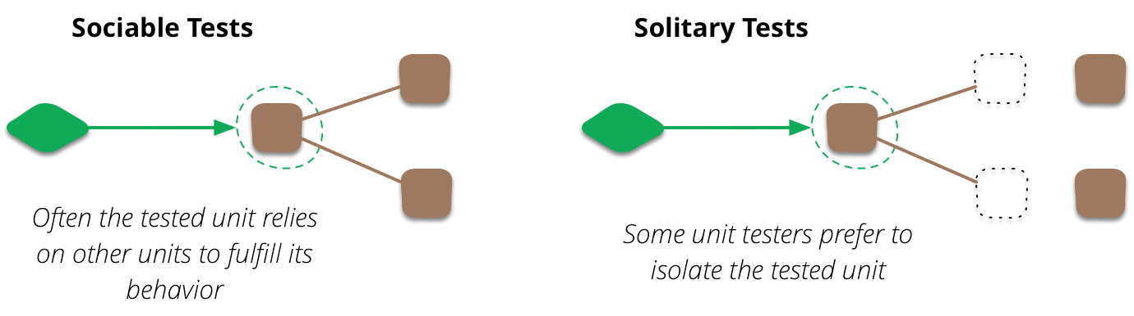
What makes a unit?
Notes:
What makes unit?

Slide 13
Characteristics of unit test
Fast
Independent
Reliable
Notes:
What makes unit?

Slide 14
Best Practices
Arrange, Act, Assert
One Assert Per Test Method
Avoid Test Interdependence
Recognize Test Setup Pain as a Smell
Add Them to the Build
Notes:
What makes unit?

Slide 15
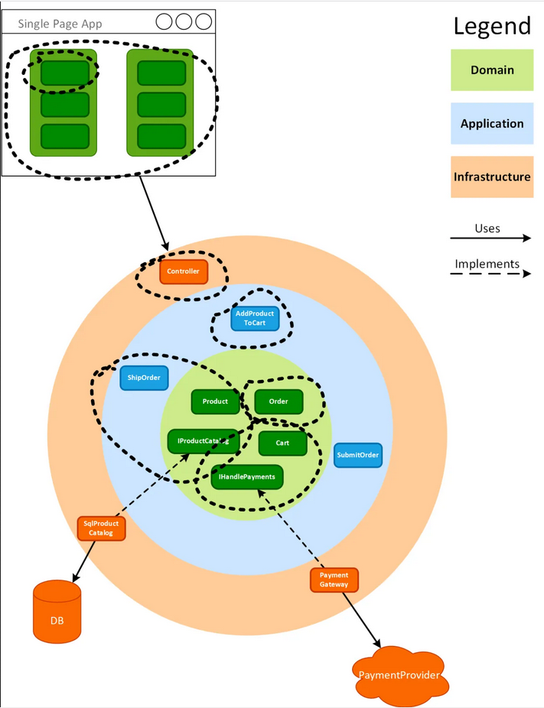
Unit Test

Slide 16
Integration Test
Notes:
What makes unit?

Slide 17
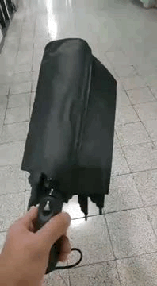
What’s wrong?
Notes:
What makes unit?

Slide 18
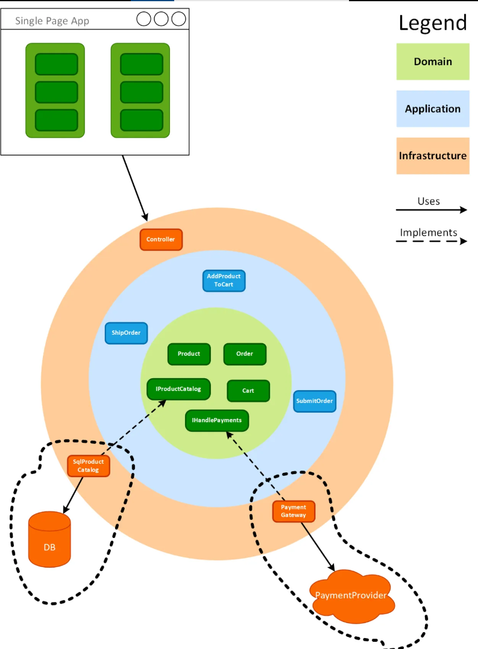
Integration Test

Slide 19
E2E Test
Notes:
What makes unit?

Slide 20
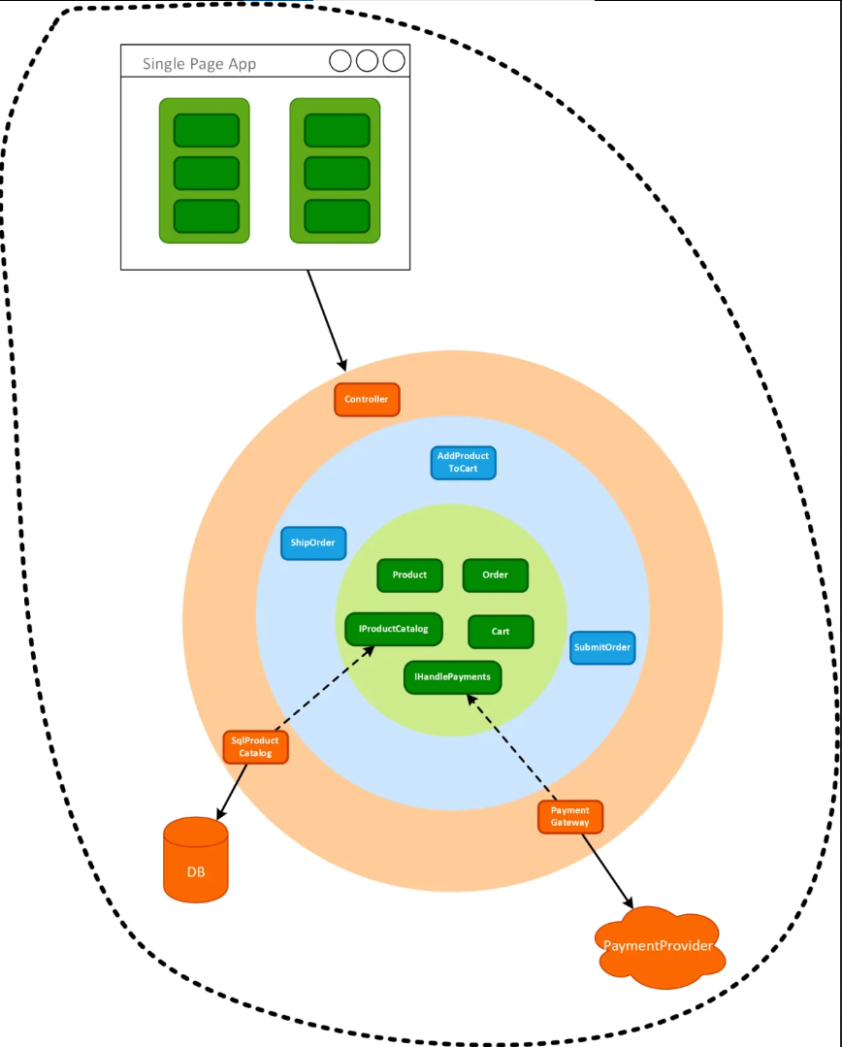
E2E Test

Slide 21
Let’s see it in action!
Notes:
What makes unit?

Slide 22
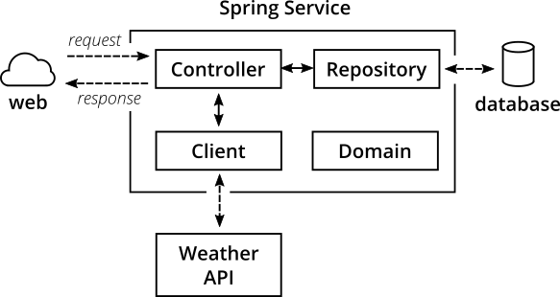
Testing Pyramid

Slide 23
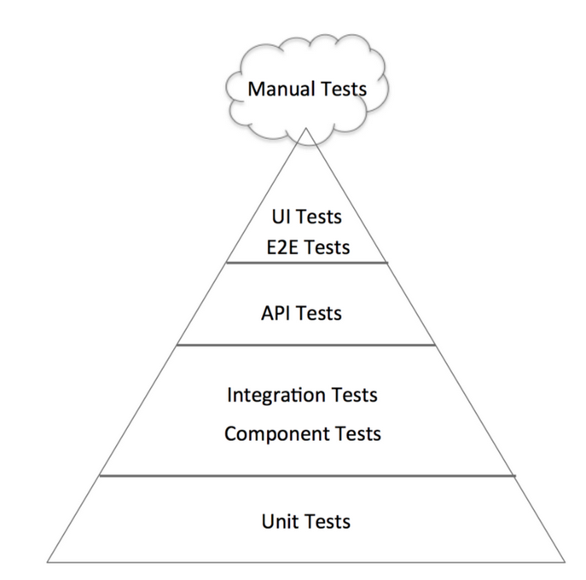
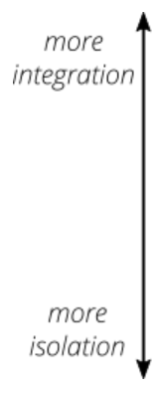
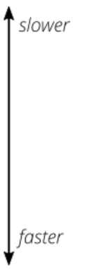
Testing Pyramid

Slide 24
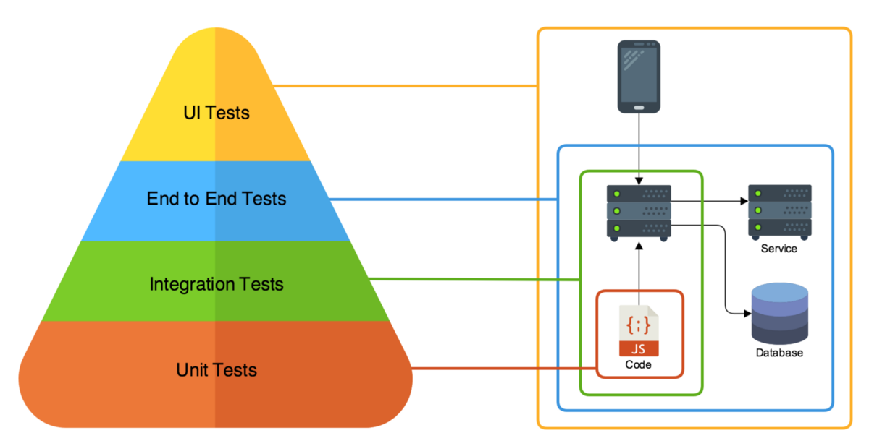
Testing Pyramid

Slide 25

There are no silly questions :)

Slide 26
#LifeKoKaroLift
Thank You!

